Slide 1

MIRPUR UNIVERSITY OF SCIENCE AND TECHNOLOGY (MUST), MIRPUR DEPARMENT OF COMPUTER SCIENCE & INFORMATION TECHNOLOGY

Slide 2
Professional Practices BIT-4802 Lecture [11]: Security and Privacy: Computers and Internet
Dr. Samina Khalid
(Lecturer)
Date: April 23, 2020

Slide 3

Today’s Agenda
Virus
Virus Transmission
Getting Infected
Precaution
Privacy
How did they get my data
Privacy Legislation

Slide 4
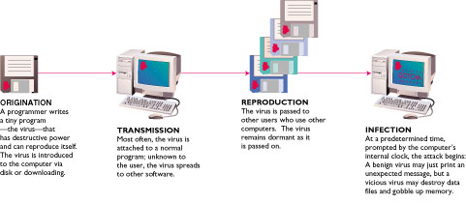
Virus Transmission
Networks
Diskettes
Professional Practices
4

Slide 5
Virus Getting Infected
Executing the virus program
Booting from a diskette containing an infected boot sector including accidentally leaving a “non-system disk” in the floppy drive
Downloading an infected file and executing it
Opening an infected e-mail attachment
By viewing e-mail in some versions of Microsoft Outlook

Slide 6
Virus Precautions
Be aware of free software from the Internet or friends
Only install programs from diskettes in sealed packages
Use virus-scanning software to check any file or document before loading it onto your hard disk

Slide 7
Privacy
Where is my data?
How is it used?
Who sees it?
Is anything private anymore?
Everything about you is in at least one computer file

Slide 8
Privacy How Did They Get My Data?
Loans
Charge accounts
Orders via mail
Magazine subscriptions
Tax forms
Applications for schools, jobs, clubs
Insurance claim
Hospital stay
Sending checks
Fund-raisers
Advertisers
Warranties
Military draft registration
Court petition

Slide 9
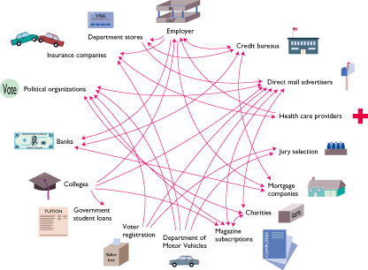
Privacy How Did They Get My Data?

Slide 10
Privacy Legislation
Fair Credit Reporting Act – 1970
Freedom of Information Act – 1970
Federal Privacy Act – 1974
Video Privacy Protection act – 1988
Computer Matching and Privacy Protections Act – 1988

Slide 11
Privacy Your Boss is Spying on You!
Monitoring software
Screens
E-mail
Keystrokes per minute
Length of breaks
What computer files are used and for how long
Privacy groups want legislation requiring employers to alert employees that they are being monitored.
Professional Practices
11

Slide 12
Privacy Monitoring by Web Sites
Records:
City
Site you just left
Everything you do while on the site
Hardware and software you use
Click stream
Series of clicks that link from site to site
History of what the user chooses to view
Professional Practices
12

Slide 13
Privacy Monitoring by Web Sites
Cookie
Stores information about you
Located on your hard drive
Beneficial uses
Viewing preferences
Online shopping
Secure sites retain password in cookie
Controversial use
Tracking surfing habits for advertisers
Can set browser to refuse cookies or warn before storing
Software available to manage cookies

Slide 14
Privacy
P3P
Platform for Privacy Preference Project
Standards proposed by the World Wide Web Consortium (W3C)
User sets privacy preferences
Web server transmits privacy policies
Software determines if web site meets users’ requirements
Participation by web site is voluntary
Notes:
The Platform for Privacy Preferences (P3P) is a standard for websites to declare their privacy policies in a machine-readable format. It allows websites to communicate their data collection and use practices to users and user agents (like browsers), helping users make informed decisions about sharing personal information.

Slide 15

Junk e-mail
Cheaper than snail mail
The ordinary postal system as opposed to email.
Spamming
Sends e-mail messages to “everyone”
Professional Practices
15

Slide 16
Junk e-mail
Help eliminate junk e-mail
Do not complete a member profile with online service
Do not fill in registration forms unless the source promises not to sell or exchange your information
Never respond to spamming
Use filter software
Professional Practices
16

Slide 17
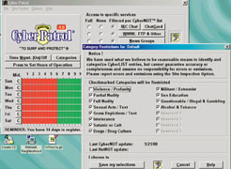
Protecting Children
Blocking software – high-tech chaperone
Examine browser history to see what sites are visited
Professional Practices
17

Slide 18
Protecting Children
Laws
Communications Decency Act – 1996
Children’s Online Privacy Protection Act (COPPA) – 2000
Professional Practices
18

Slide 19
References
Zlatanov, N., Computer security and mobile security challenges.
Lowen, A.C., Mubareka, S., Steel, J. and Palese, P., 2007. Influenza virus transmission is dependent on relative humidity and temperature. PLoS Pathog, 3(10), p.e151.
Patrick, A.S. and Kenny, S., 2003, March. From privacy legislation to interface design: Implementing information privacy in human-computer interactions. In International Workshop on Privacy Enhancing Technologies (pp. 107-124). Springer, Berlin, Heidelberg.
Reagle Jr, J., 2013, November. Designing a social protocol: Lessons learned from the platform for privacy preferences project. In Telephony, the Internet, and the Media: Selected Papers From the 1997 Telecommunications Policy Research Conference (p. 215). Routledge.
Bates, C.L., Cragun, B.J. and Day, P.R., International Business Machines Corp, 2004. Method and computer program product for implementing parental supervision for internet browsing. U.S. Patent 6,745,367.

Slide 20
THANKS

